Slide 1
Apple Stock Trading
RUIJIA YANG
SHALABH MITTAL
PIYUSH PRASHANT
ZHICHAO PAN

Slide 2
Agenda
Overview
Exploratory Data Analysis
History
Stock Price Prediction Models
Trading Strategies
Random Forest Implementation
Project objective
Proposed solution
Improvements

Slide 3

Overview
Apple (ticker symbol: AAPL) is one of the world's leading consumer electronics and personal computer companies. Apple focuses on developing its own hardware, software, operating systems and services to provide its customers with the best user experience possible. They have continued to focus on personal computers for the following decades, but in recent years that focus has shifted more to consumer electronics such as the iPhone, iPad and iPod. However, Apple also sells a range of related software, services and applications, with some of the most prominent non-electronics products being the iCloud, iOS, Mac OS and Apple TV. Despite Apple's market-leading position, the company still faces a number of risk factors, which include changing global economic conditions, fluctuating consumer demand, worldwide-competition and potential supply chain disruptions.

Slide 4
HISTORY

Slide 5
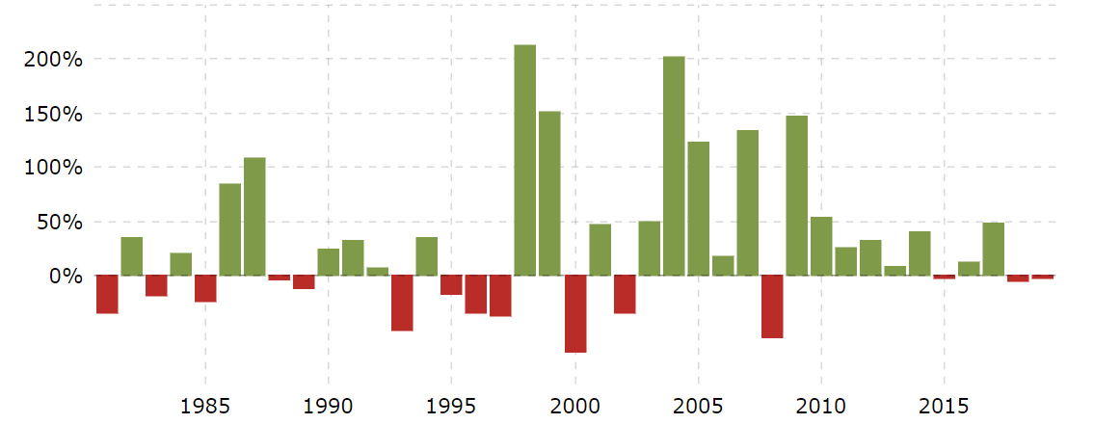
1985: Jobs leaves Apple
Jobs was ousted by the board of directors in an apparent coup. The company’s leadership instability resulted in the stock falling to below $2 per share.
1998: The first iMac is unveiled.
Jobs introduced the colorful and translucent desktop less than a year after he returned to the company.
2014: Apple stock splits.
APPL share prices dropped from a prohibitive $645.57 to about $92.44.
Apple Historical Annual Stock Price Data
1997: Steve Jobs returns.
Jobs was brought back as interim chief.
2007: The iPhone debuts.
The mobile device signaled the beginning of the mobile revolution. The iPhone was the best-selling tech product in 2017, ten years after its launch, USA Today reported.

Slide 6
Problems to solve
Exploratory Data Analysis of apple stock data to figure out parameters to create machine learning models.
Creating Random forest to optimize our models and get the optimal results.
1
3
2
Developing different machine learning algorithms to predict stock prices.
4
Creating Investment Strategies for trading our stocks using predicted stock price to get the return on investment and other parameters.

Slide 7
Project objective
The art of forecasting stock prices has been a difficult task for many of the researchers and analysts. In fact, investors are highly interested in the research area of stock price prediction. For a good and successful investment, many investors are keen on knowing the future situation of the stock market. Good and effective prediction systems for stock market help traders, investors, and analyst by providing supportive information like the future direction of the stock market. In this work, we present a Regression models and Long Short-Term Memory (LSTM) approach to predict stock market indices. Using those we will produce investment return using our trading strategy to complete our portfolio.

Slide 8
Exploratory Data Analysis

Slide 9
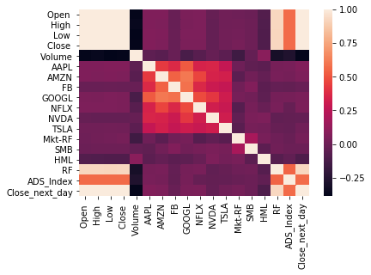
Features Selection

Slide 10
Stock Price Prediction Models

Slide 11
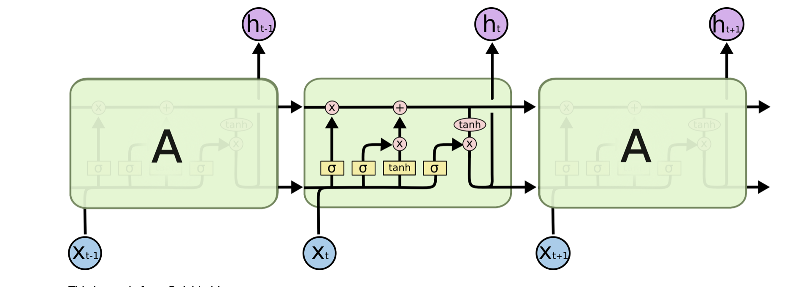
Model 01: LSTM
An Artificial RNN used in the field of deep learning.
Well-suited to classifying, processing and making predictions based on time series data, since there can be lags of unknown duration between important events in a time series.
LSTM unit is composed of a cell, an input gate, an output gate and a forget gate.
Makes small modifications to the information by multiplications and additions.

Slide 12
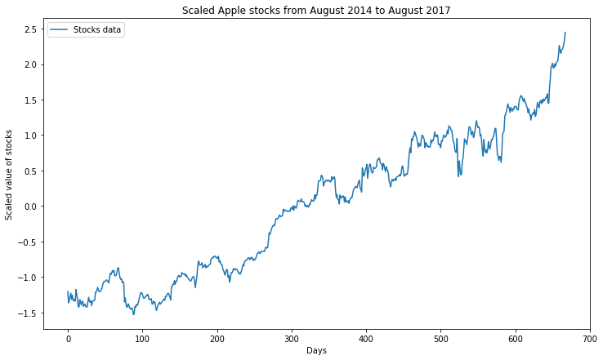
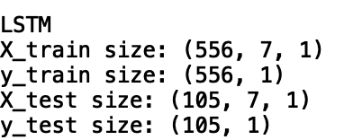
Scaling the Input Data Set.
Transforming Train and Test Data to Vector form for calculating weights.

Slide 13
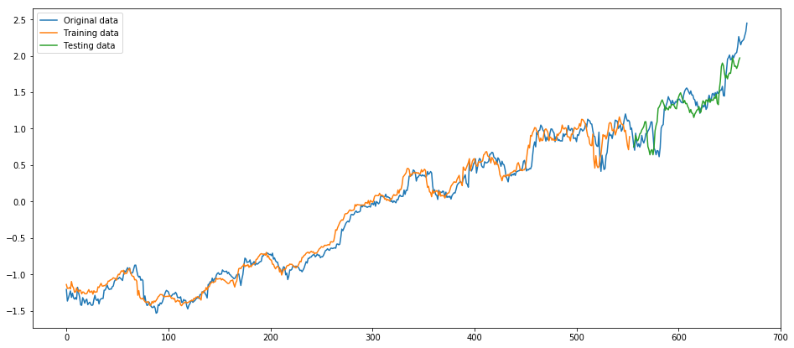
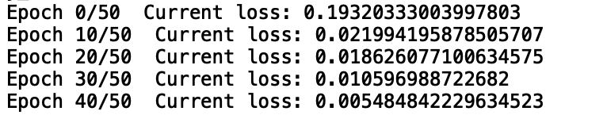
LSTM Prediction
R Squared of LSTM is: 0.90

Slide 14
‘Random Forest’ Structure 01 Bagging for regression
Bootstrap N samples
Compare R square
Keep the Best N models
Train on Each models
Average results

Slide 15
‘Random Forest’ Structure 02
Bagging
LSTM Algorithm
Prediction Price

Slide 16
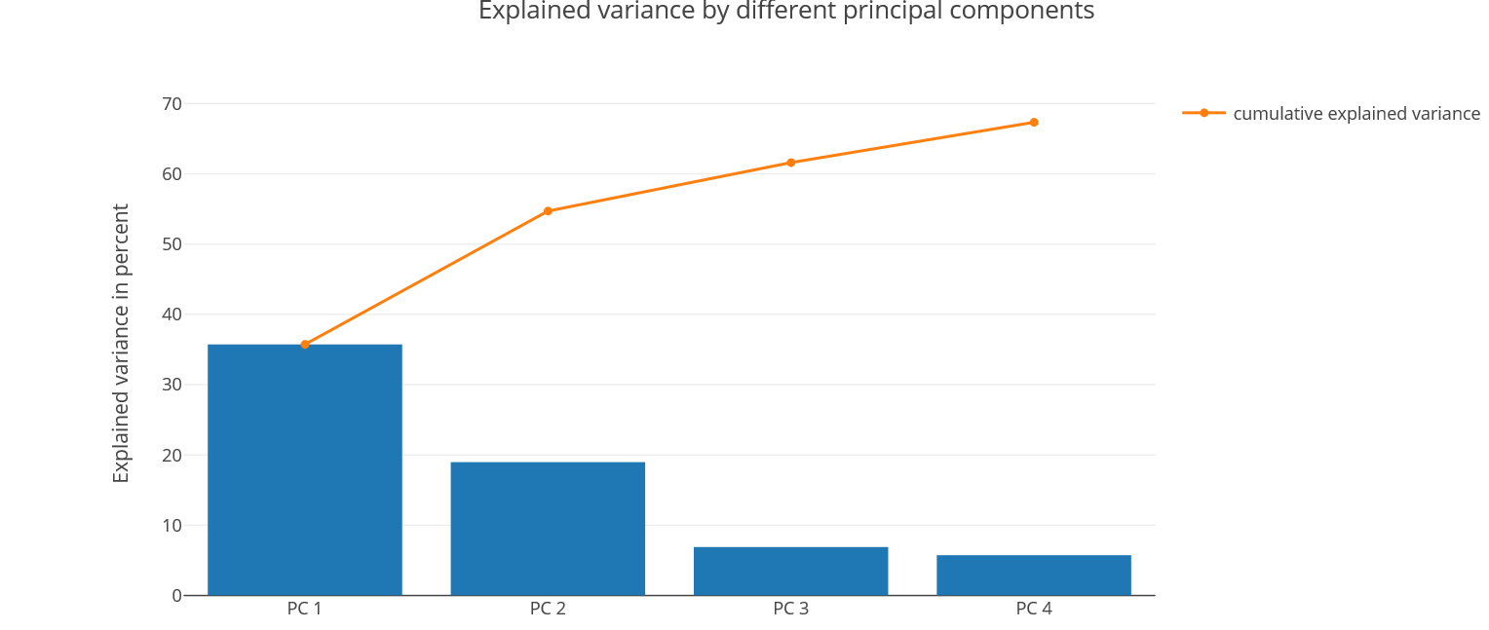
Model 02: Principal Component Analysis - OLS
A statistical procedure that uses an orthogonal transformation to convert a set of observations of possibly correlated variables into a set of values of linearly uncorrelated variables called principal components.
Used for dimensionality reduction
Components try to capture as much variance as they can in the data

Slide 17
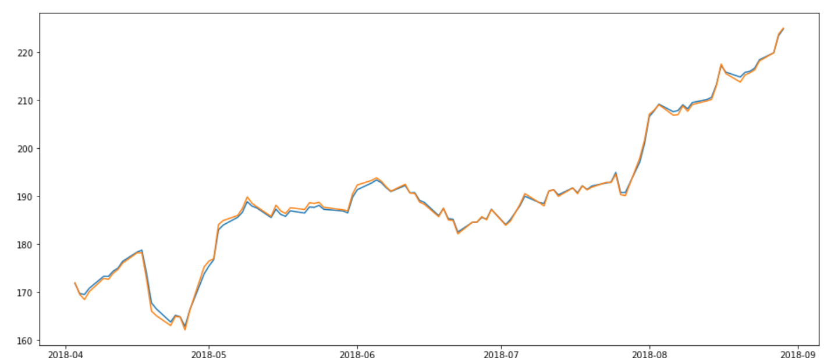
Predicted closed price versus actual close price on test data
R-Squared and Estimated Coefficients value after OLS implementation on Test Data.

Slide 18
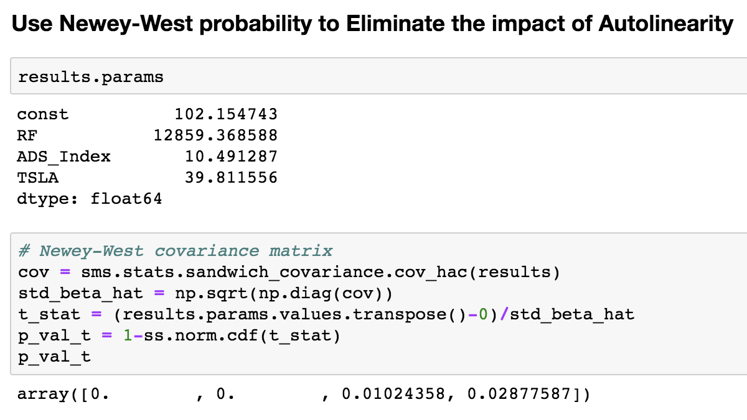
Models 03/04: OLS + Newey-West
Correlation + Stepwise method
RF + ADS_Index + TSLA
Fama - French
R_Sq: 0.863
Newey-West: Autocorrelation

Slide 19

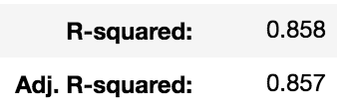
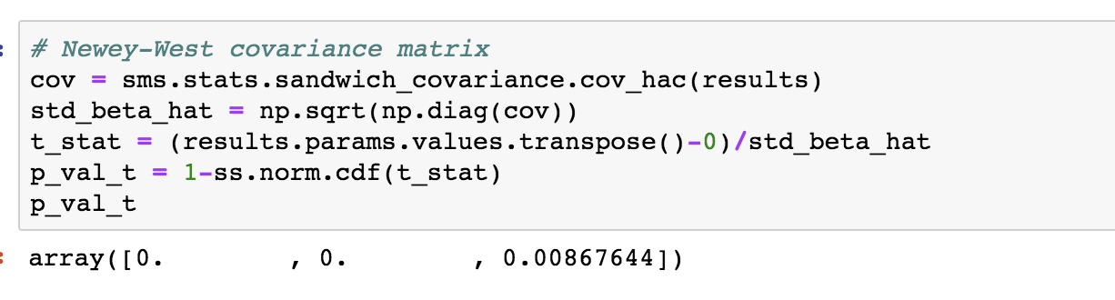
Model 05: Polynomial
Preprocessing:
Polynomial Features with degree 2
Newey – West test result

Slide 20
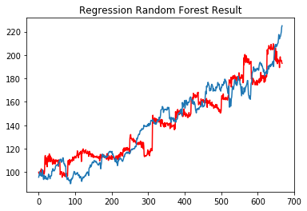
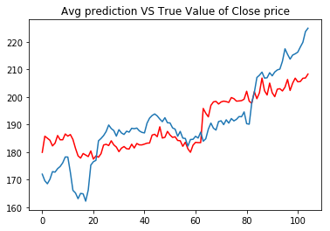
R Squared of Random Forest for regression models is 0.83

Slide 21
Model 06: GRU
Based on LSTM professor taught in class and what my teammate have done. I searched another variant of LSTM called GRU(Gated Recurrent Unit) .
GRU also address the shortcoming of RNN which can not handle the information in long sequences.
GRU just use reset gate and update gate. The reset gate is used to determine how much the past information to forget. The update gate is combined with forget gate and input gate of an LSTM.
Since GRU has fewer matrix operations, it’s little speedier to train then LSTM’s. However, we usually try both to determine which one should be chosen.

Slide 22
GRU Prediction

Slide 23
Trading Strategy 01:
Compare the Open price and Predicted Close price.
If Open < Predicted Price:
We Purchase it and sell it at the closing price.
.
Otherwise we won’t trade.
﻿Assuming we have $100000.0 to invest, based on the approximate price of $170 per share, then we can help you earn $114547.06
The return rate is: 15.0 % for the past 3 months.
Gross Profit: 64.13
Gross Loss: -39.40
Sharpe Ratio using Strategy 1: 0.63(Annual)

Slide 24
Trading Strategy 02: BOLLINGER BANDS
BB are used to determine overbought and oversold levels, where a trader will try to sell when the price reaches the top of the band and will execute a buy when the price reaches the bottom of the band.
The BB has 3 components:
Middle line which is The 20 day simple moving average of the closing prices
An upper band – this is the +2 standard deviation of the middle line
A lower band – this is the -2 standard deviation of the middle line

Slide 25
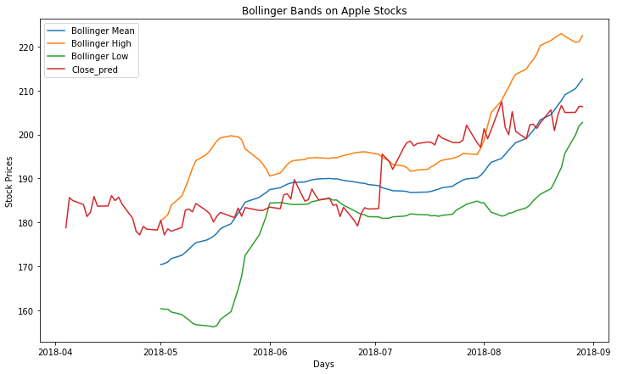
Investment Results
﻿Assuming we have initially bought shares at price $170 per share with half of our initial investment.
Assuming we have $100000.0 to invest using Bollinger Bands, based on the approximate price of $170 per share, then we can help you earn $106686.21 .
The return rate is: 6.69 % for the past 3 months.
Sharpe Ratio using Bollinger Bands: 7.83

Slide 26
Trading Strategy Comparisons

Slide 27
Trading Strategy 01:
Trading Strategy 02:
INVESTMENT : $100,000.00
TOTAL EARNED: $ 114547.06
GROSS PROFIT: $64.13
GROSS LOSS: ($39.40)
NET PROFIT: $16535.29
RETURN RATE: 15%
SHARPE RATIO: 0.63(Annual)
INVESTMENT : $100,000.00
TOTAL EARNED: $106686.21
NET PROFIT: $6686.21
RETURN RATE: 6.69%
SHARPE RATIO: 7.83(Annual)

Slide 28
Proposed Solution
After Implementing 2 different strategies, we found out that return depends upon the investors and type of trading they want, for e.g. day trading.
If the investor wants a stable and less risky investment then they should go with Bollinger Bands and if they are looking for high return and have the guts to take the risk, they can choose day trading.

Slide 29
IMPROVEMENTS
More years of stock data to improve our results.
Run our models on Cloud(GPU) for faster processing.
Use of different machine Learning algorithms to improve our prediction.
More understandability of Trading Strategies to produce real-time returns.
Use different stocks to create investment portfolio.

Slide 30
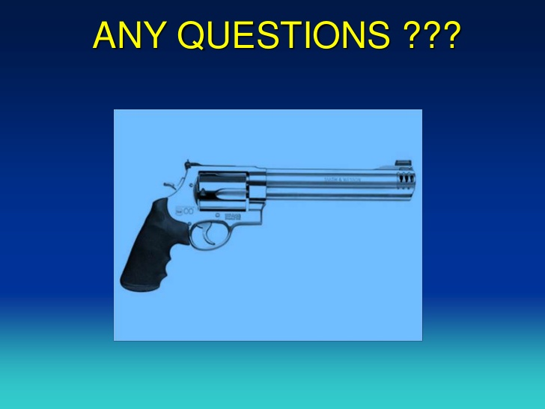

Slide 31
THANK YOU

